Slide 1


2026 Iowa Renewable Fuels Summit
Renewable Fuels At Work
February 5, 2026

Slide 2
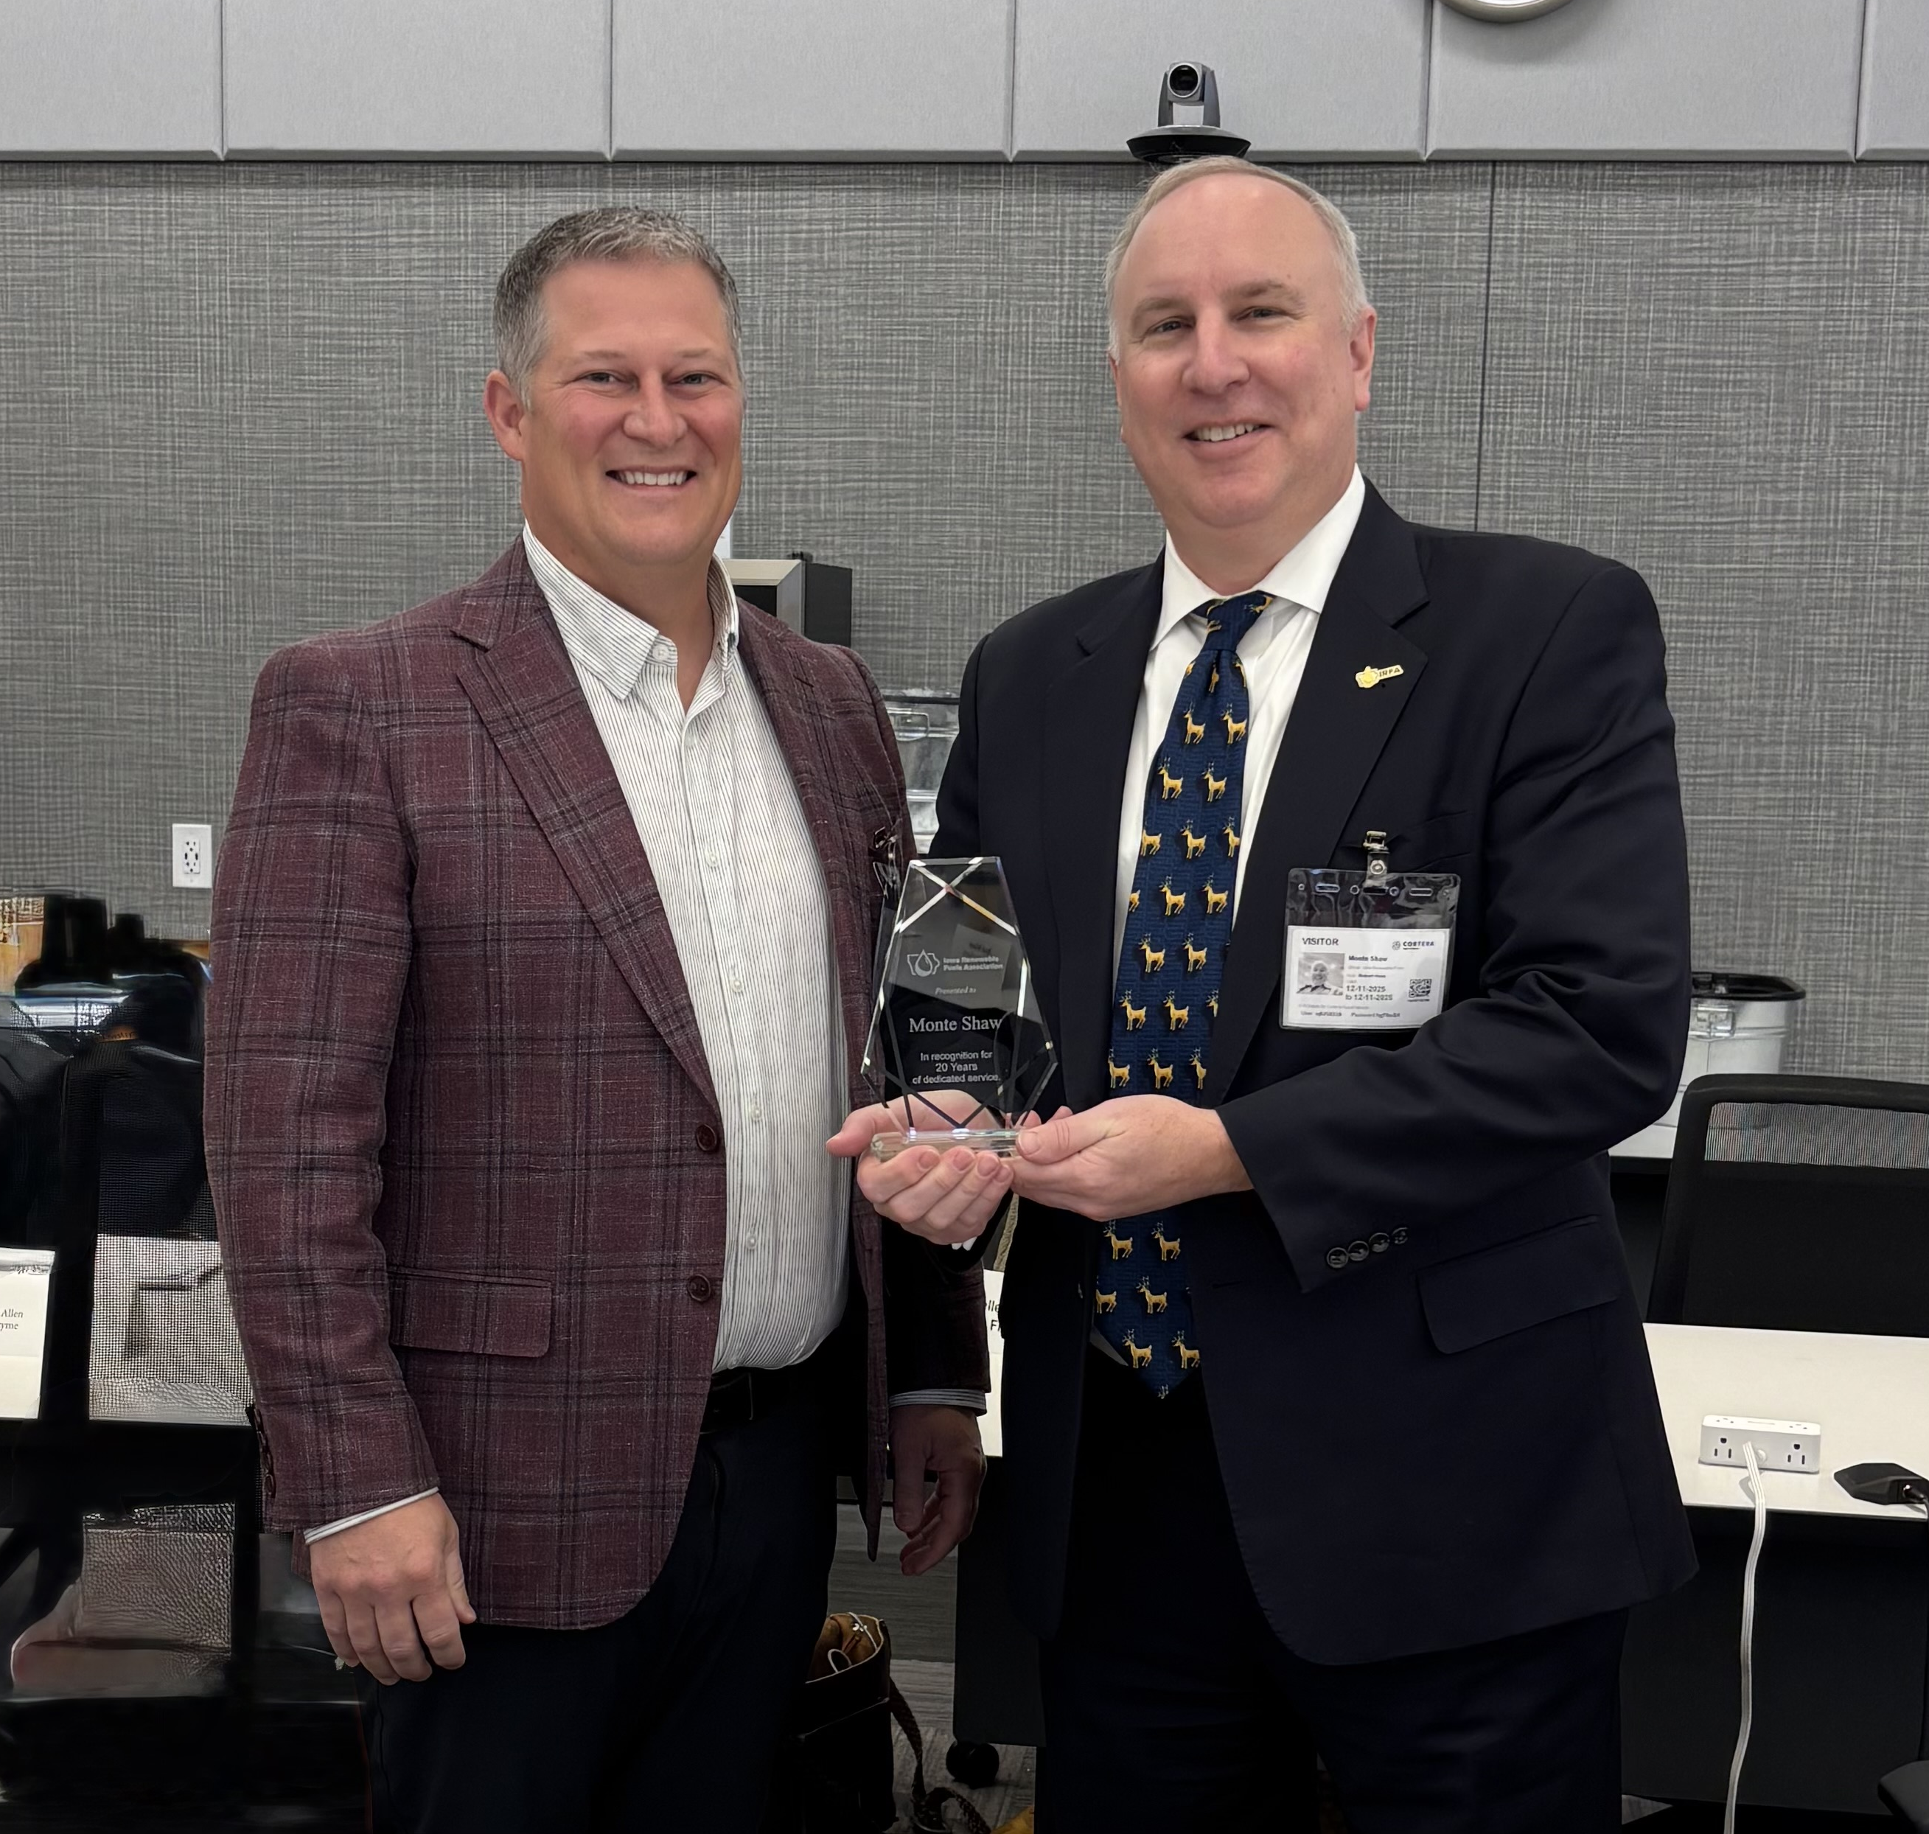
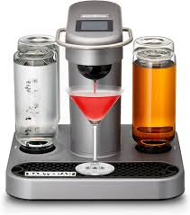
20 Year Anniversary

Slide 3

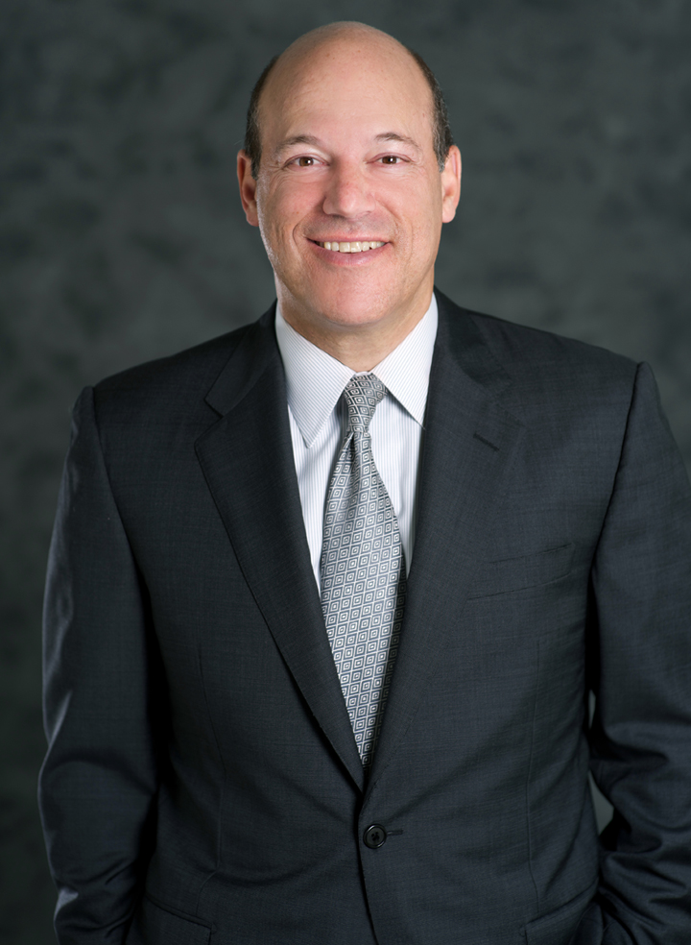
Ari Fleischer
Former White House
Press Secretary
Fox News Contributor
Fireside Chat

Slide 4
Iowa Ethanol Production

Slide 5
Iowa Biodiesel Production

Slide 6
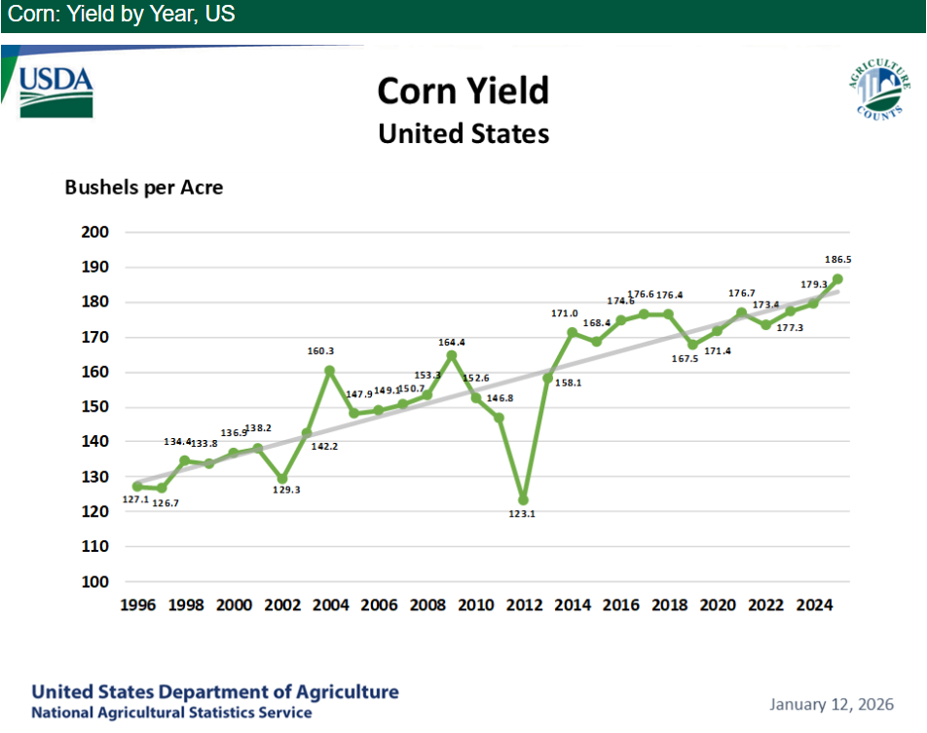
U.S. Corn Yields

Slide 7
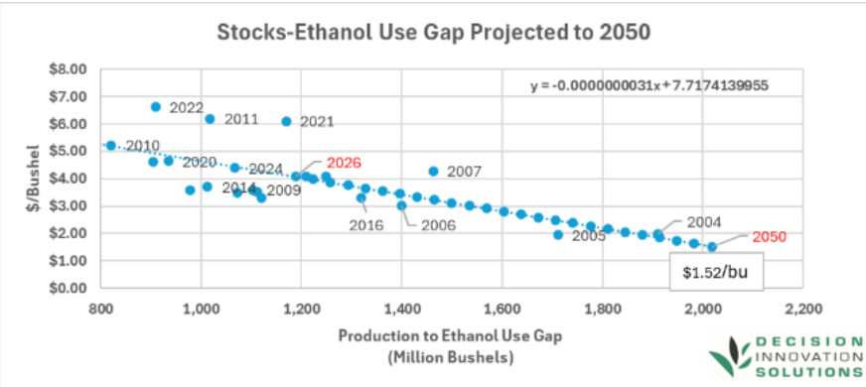
Stocks-Ethanol Use Gap

Slide 8
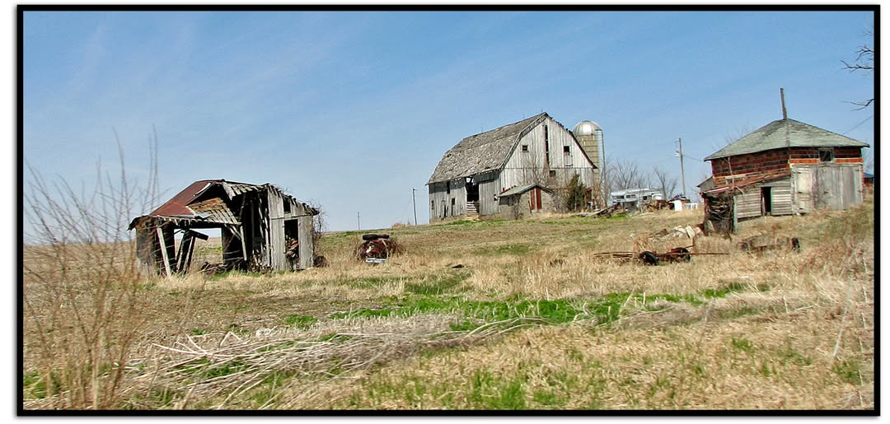

Slide 9

Farm Program Costs Exploding

Slide 10

DIS Corn Study

Slide 11
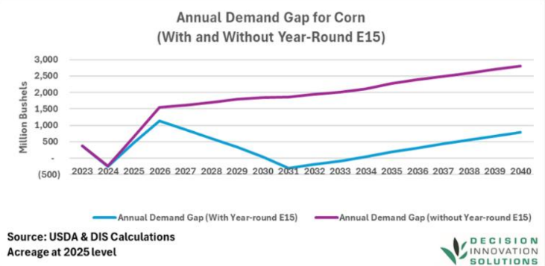
Annual Demand Gap for Corn

Slide 12
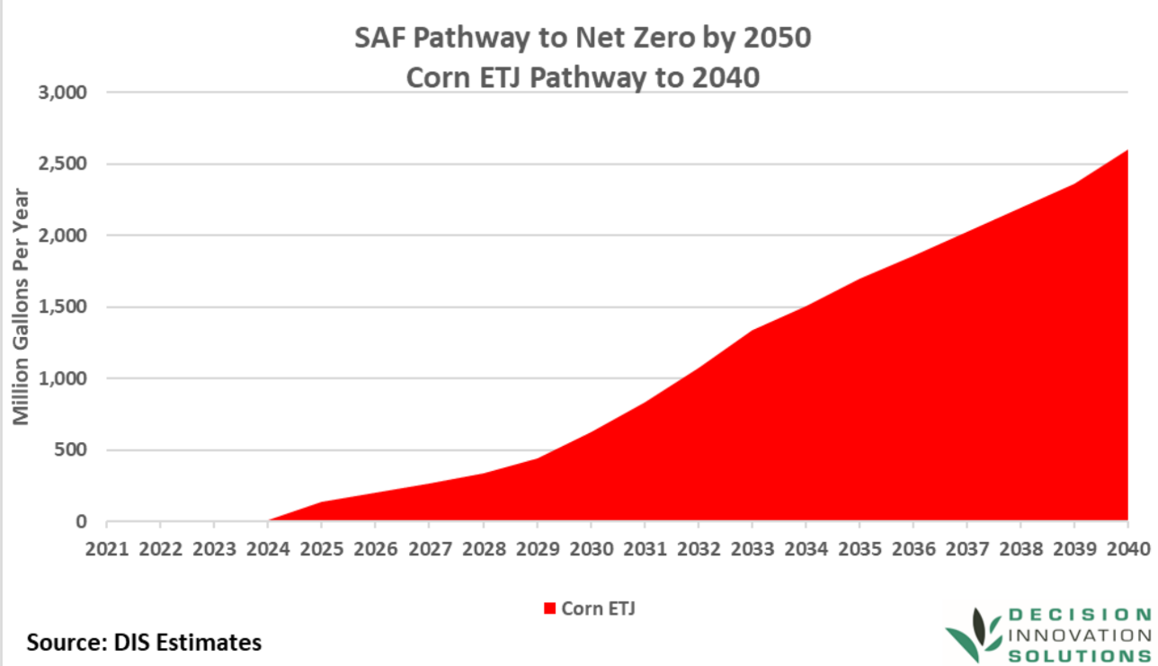
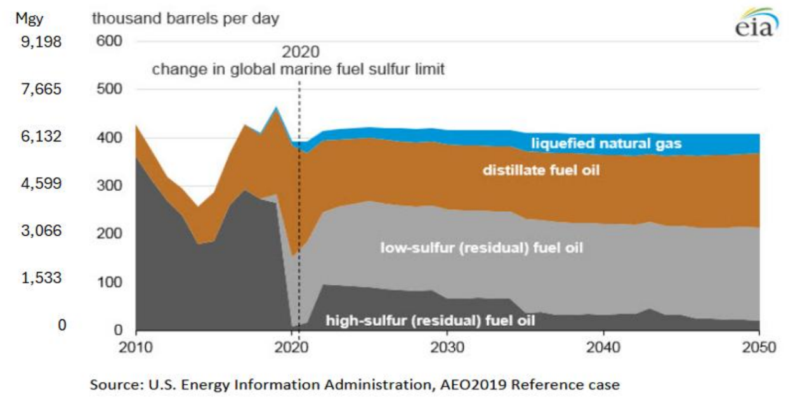
Marine & SAF Market Development

Slide 13


Upcoming Panels

Slide 14

Policy Panel

Slide 15
Source: IDALS data
Iowa E15 Stations

Slide 16
*estimated sales
Source: IDALS data
Iowa E15 Station Sales

Slide 17
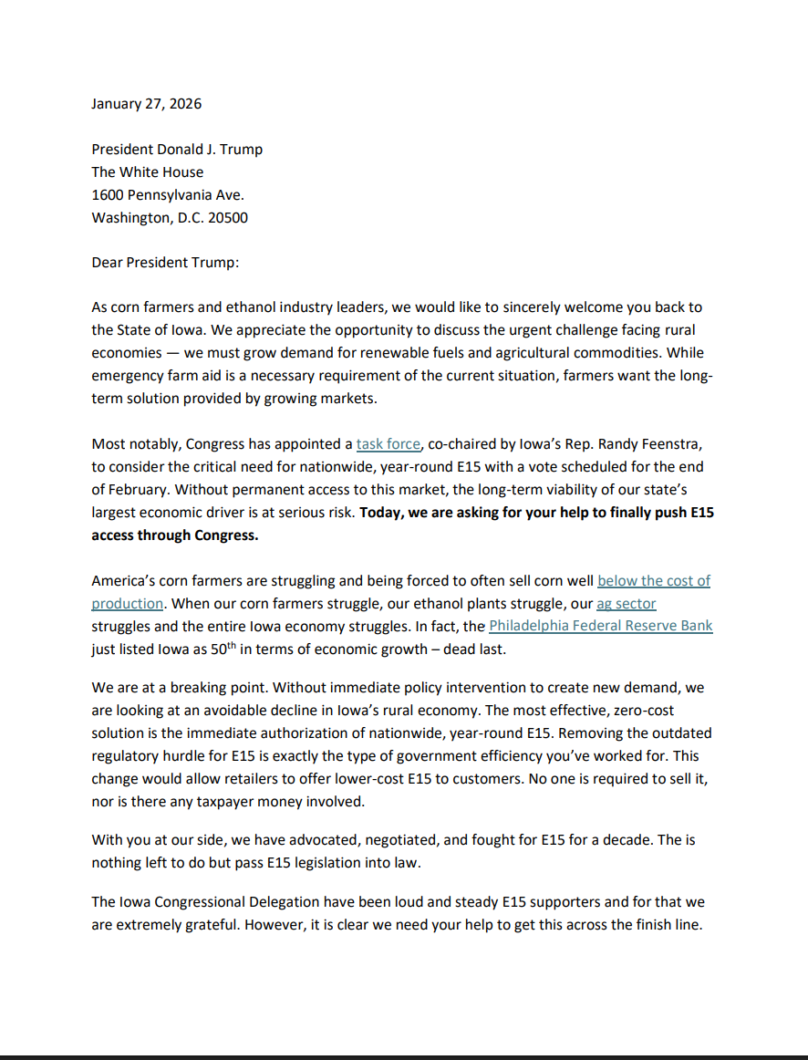

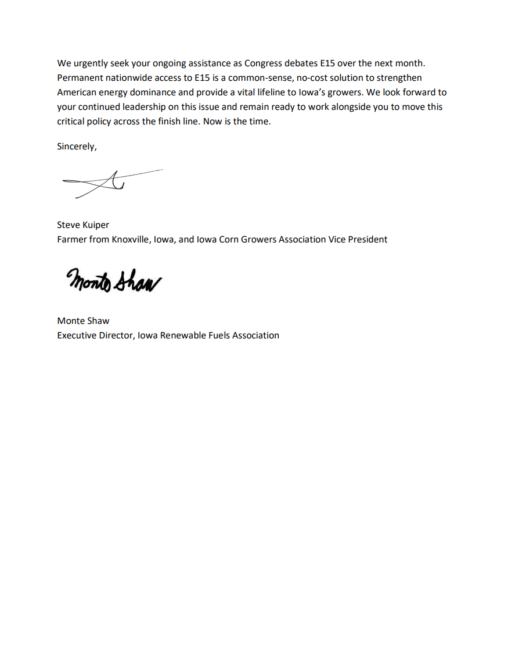


Open Letter to President Trump

Slide 18

Des Moines Register Ad

Slide 19
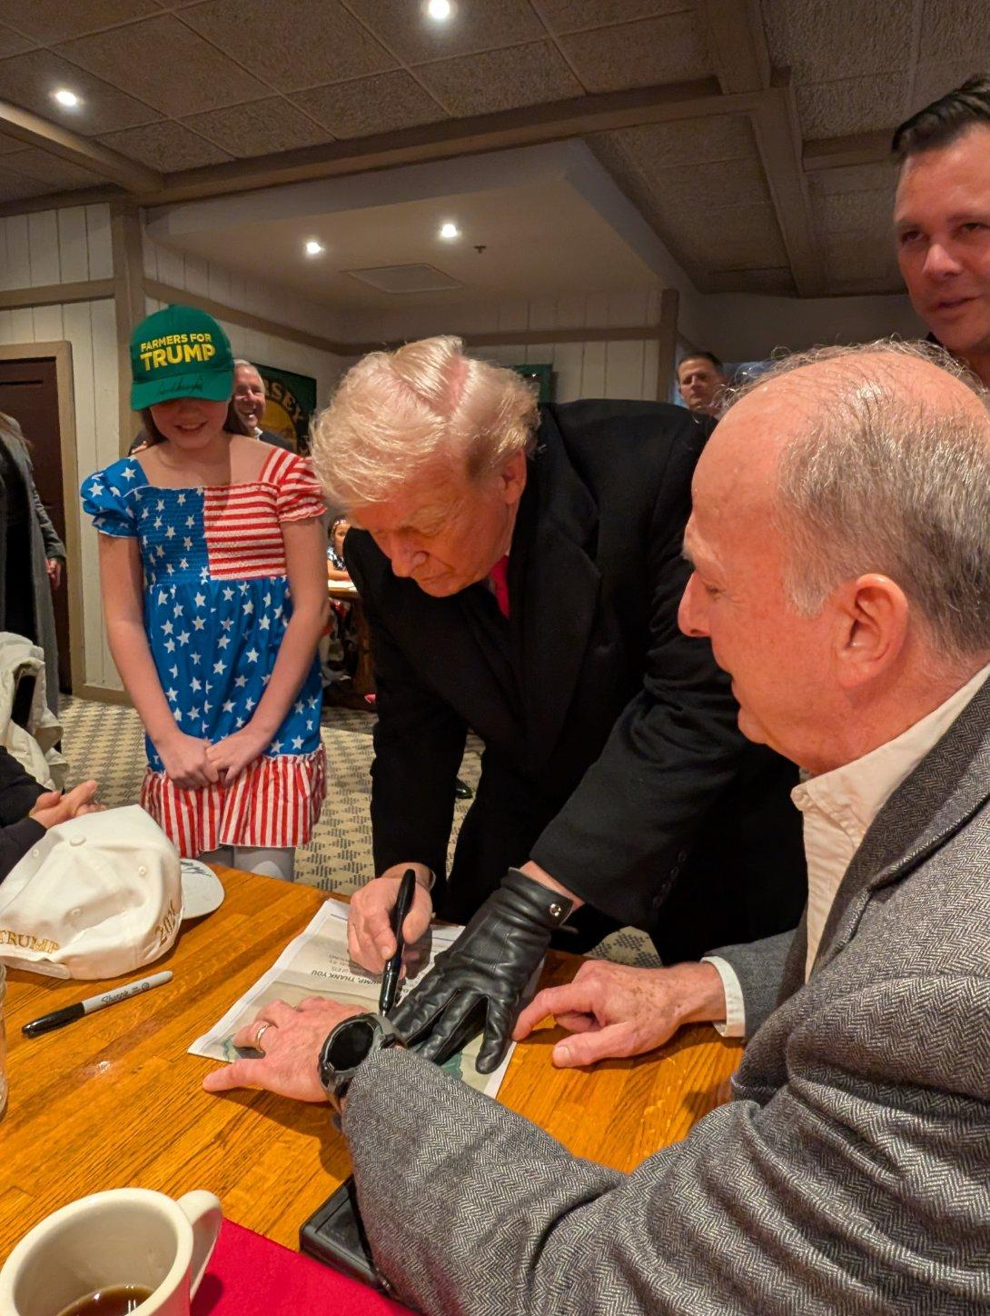

Signed Des Moines Register Ad

Slide 20
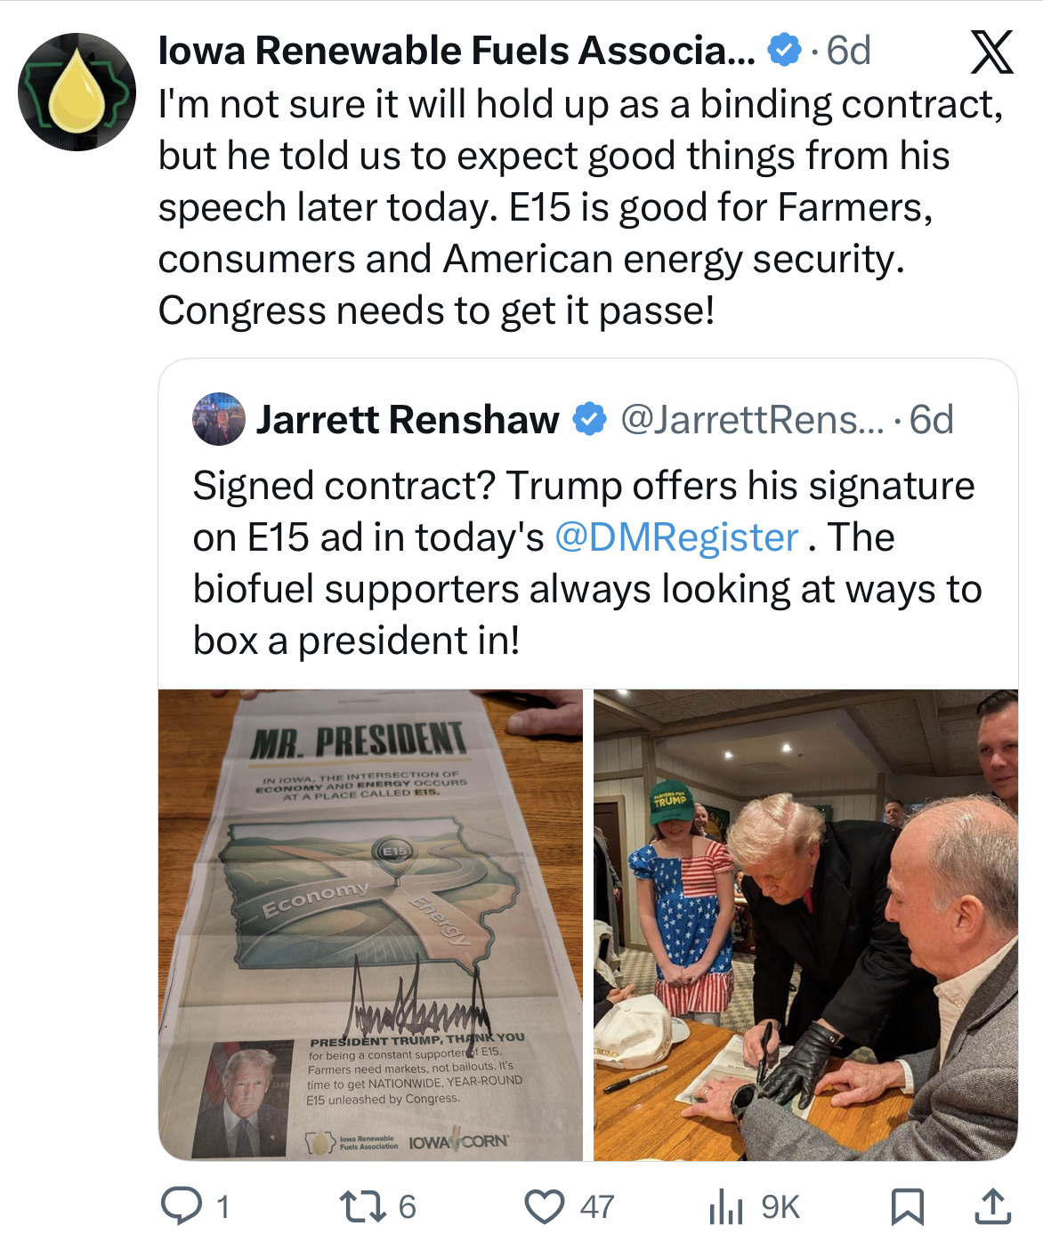
X (Twitter) Post

Slide 21

President Trump on Year-Round E15

Slide 22

Ethanol Producer Magazine

Slide 23

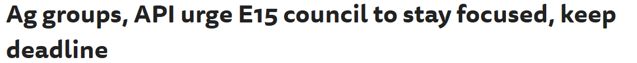

Year-Round E15 Compromise

Slide 24
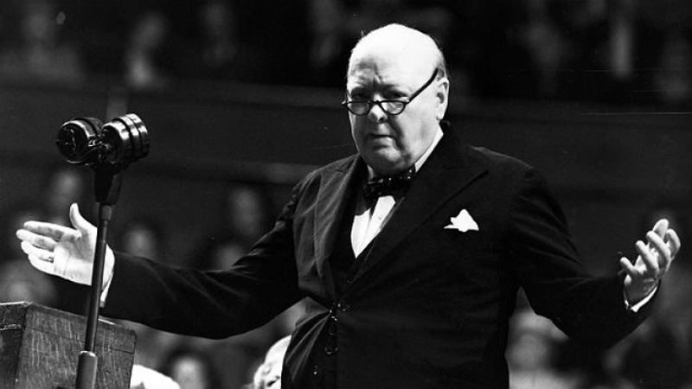
Britian will “go on to the end…we shall fight on the seas and oceans, we shall fight…in the air, we shall defend our Island, whatever the cost may be, we shall fight on the beaches, we shall fight on the landing grounds, we shall fight in the fields and in the streets, we shall fight in the hills; we shall never surrender...”
Winston Churchill

Slide 25
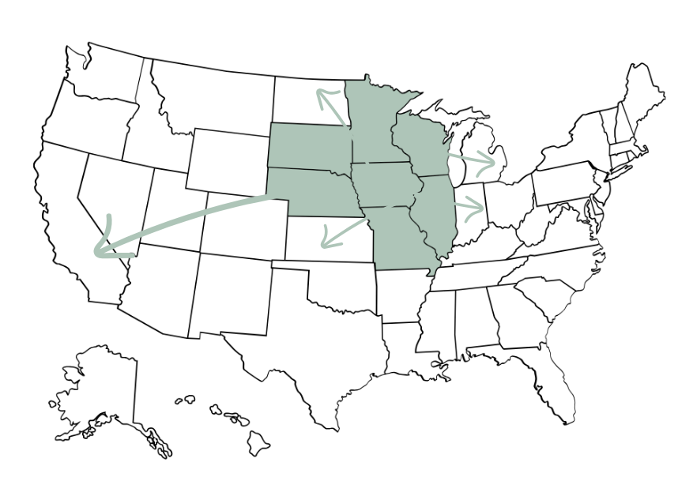
Nationwide E15

